Slide 1
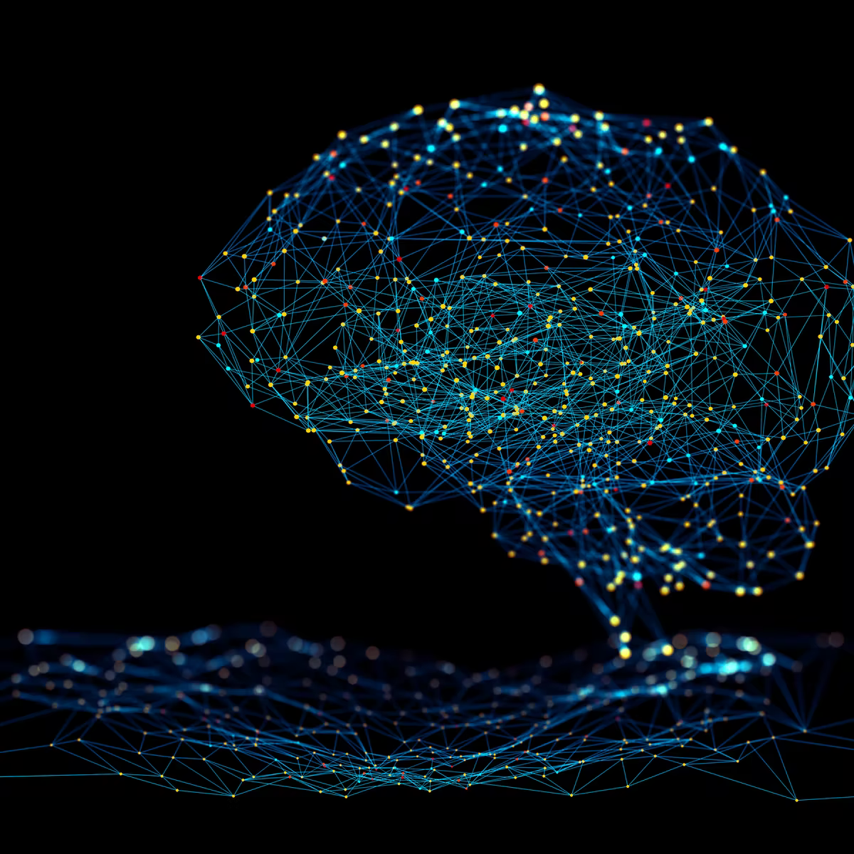
Neural Networks
Bryan Cardenas
Robert Jan Schlimbach
Caspar van leeuwen

Slide 2
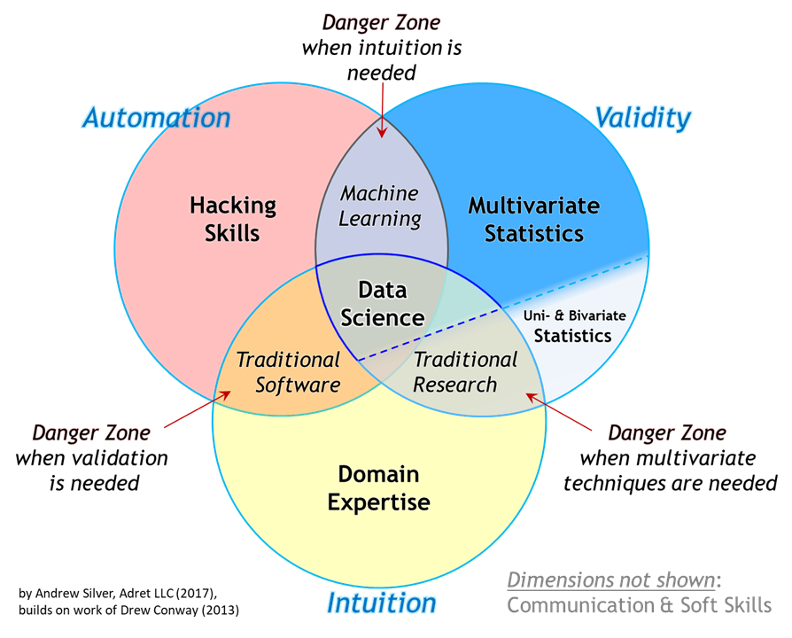
Background Prerequisites
Programming
R / Python
Statistics, Calculus
Machine Learning / Deep Learning
Parallel Computing

Slide 3
Topics List
General Introduction to ML and DL, basic principles
Algorithms and Models
Convolutional Neural Networks
Generative Models, VAE

Slide 4
Course Plan until lunch
9:00-9:45 Introduction ML & DL, basic principles
9:45-10:00 Introduction to PyTorch
10:05-10:50 Hands-on 1: fully connected network
10:50-11:00 Recap hands-on
11:00-11:15 Coffee break
11:15-11:45 CNN theory
11:45-12:30 Hands-on 2: CNN
12:30-13:30 Lunch break

Slide 5
Course Plan After Lunch
12:30-13:30 Lunch break
13:30-14:00 Recap hands-on
14:00-14:30 Coffee break
14:30-15:30 VAE theory
15:30-16:30 Hands-on 4: VAE, ‘demo’ notebook
16:30-17:00 Questions & wrap-up

Slide 6
What is Machine Learning?
It is NOT:
Mimicking human intelligence
Robotics
Deep Learning
ML is the study of computer algorithms that can improve automatically through experience and by the use of data.^{[1]} It is seen as a part of artificial intelligence.
wikipedia

Slide 7
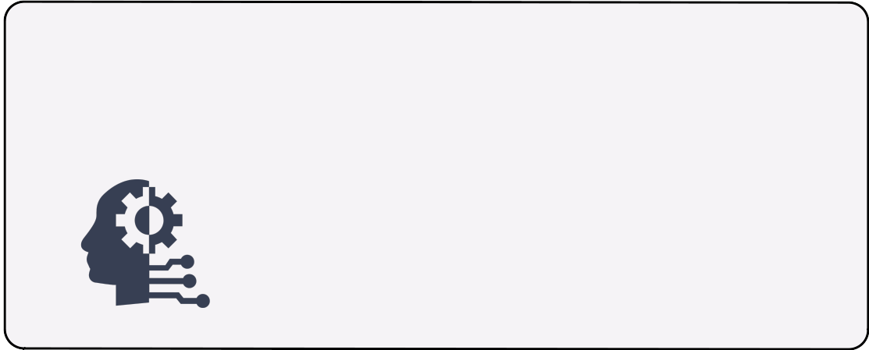
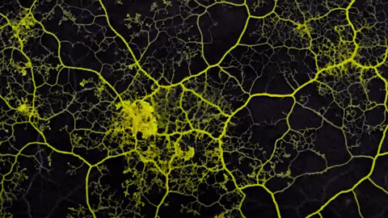
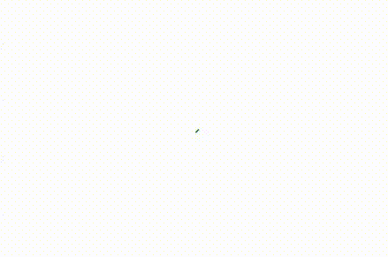
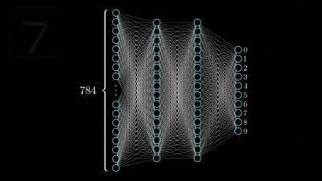
AI vs ML vs DL
Artificial Intelligence
Having computers to exert
Intelligent behaviour

Slide 8
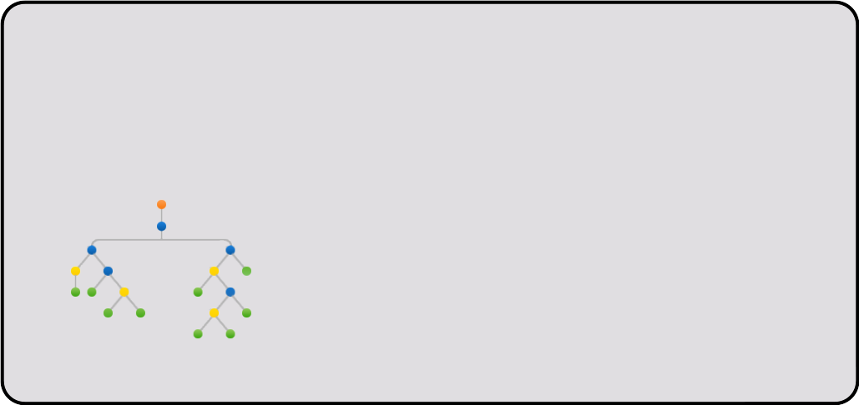
AI vs ML vs DL
Artificial Intelligence
Having computers to exert
Intelligent behaviour
Machine Learning
Perform tasks without
Explicitly programmed
from data

Slide 9
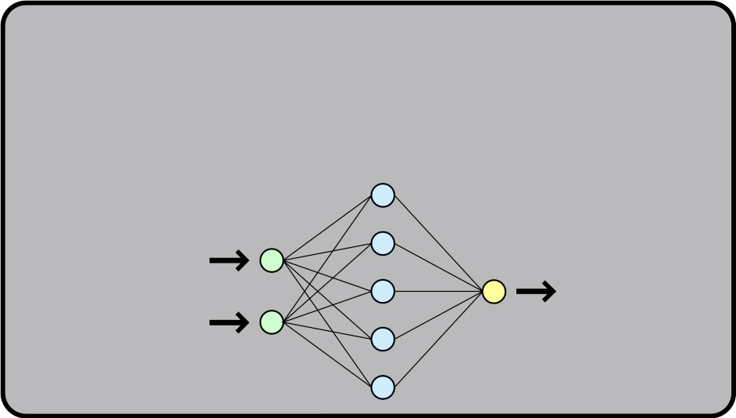
AI vs ML vs DL
Artificial Intelligence
Having computers to exert
Intelligent behaviour
Machine Learning
Perform tasks without
Explicitly programmed
from data
Deep Learning
Use (deep) neural networks

Slide 10
AI vs ML vs DL
Artificial Intelligence
Having computers to exert
Intelligent behaviour
Machine Learning
Perform tasks without
Explicitly programmed
from data
Deep Learning
Use (deep) neural networks

Slide 11
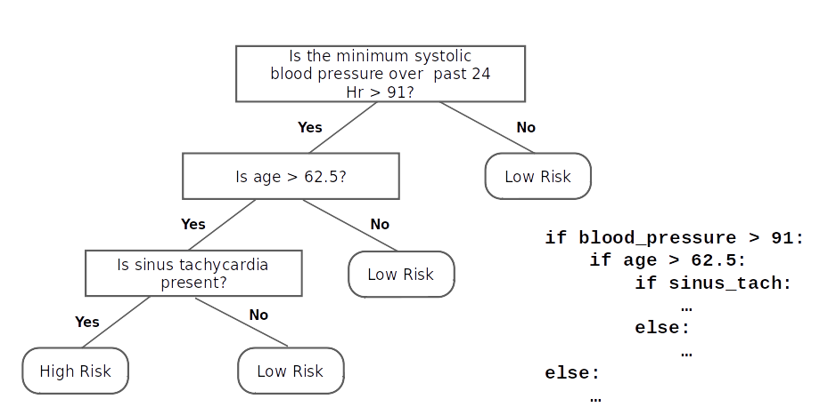
Why Machine Learning?
Think of a simple decision tree

Slide 12
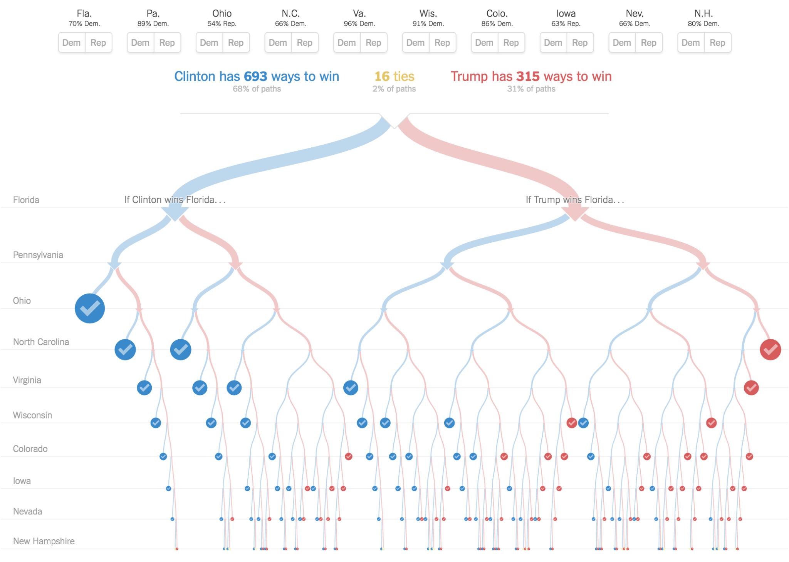
Why Machine Learning?
We probably don’t want to code a complex decision tree by hand

Slide 13
Why Machine Learning?
We probably don’t want to code a complex decision tree by hand

Slide 14

Why Machine Learning?
What is a dog?
We probably don’t want to code a complex decision tree by hand

Slide 15

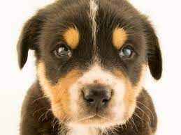
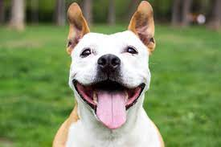
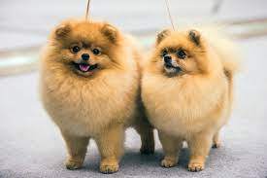

Why Machine Learning?
Driven by Data
What is a dog?

Slide 16
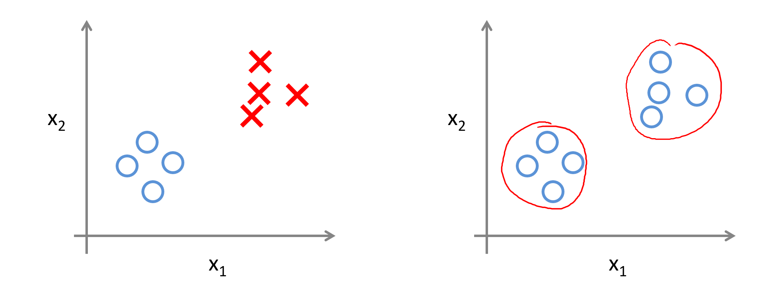
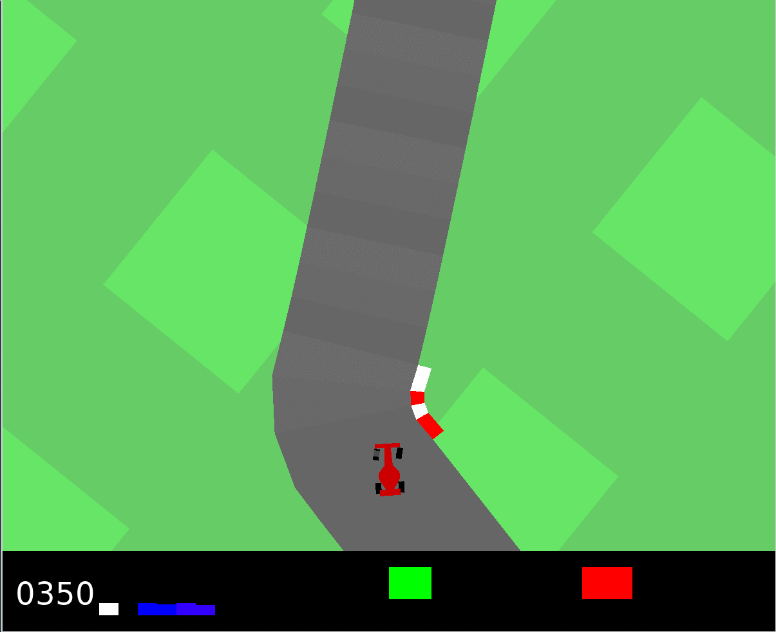
Categories of Machine Learning
Supervised
Unsupervised
Reinforcement
Learn from labels
Regression, Classification
Detect patterns in the data
Clustering, Dimensionality reduction
Learn from mistakes
Control, Gaming
We probably don’t want to code a complex decision tree by hand

Slide 17
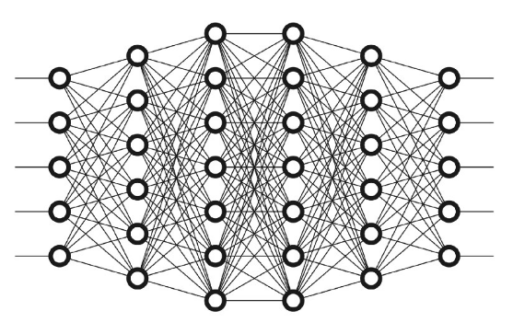
Neural Networks
Neuron
Input
Output
We probably don’t want to code a complex decision tree by hand
Use a (deep) neural network to approximate an unknown function

Slide 18
Neural Networks
Neuron
Input
Output
We probably don’t want to code a complex decision tree by hand
Use a (deep) neural network to approximate an unknown function

Slide 19
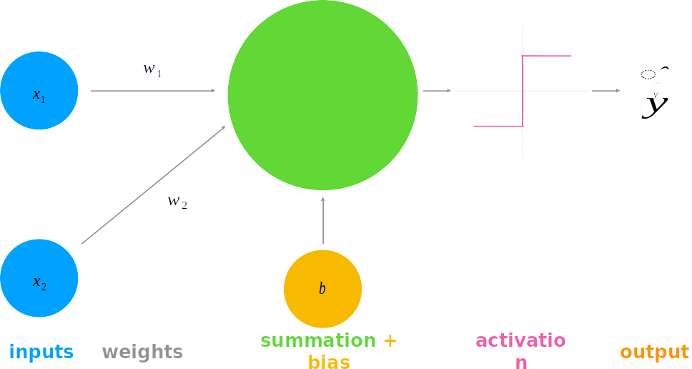
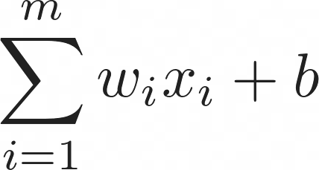
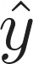
Anatomy of Neural Networks
We probably don’t want to code a complex decision tree by hand
Inputs
weights
Summation + bias
Activation Function
Output

Slide 20
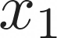
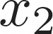
Perceptron & Activation
Binary Classification Task
0

Slide 21
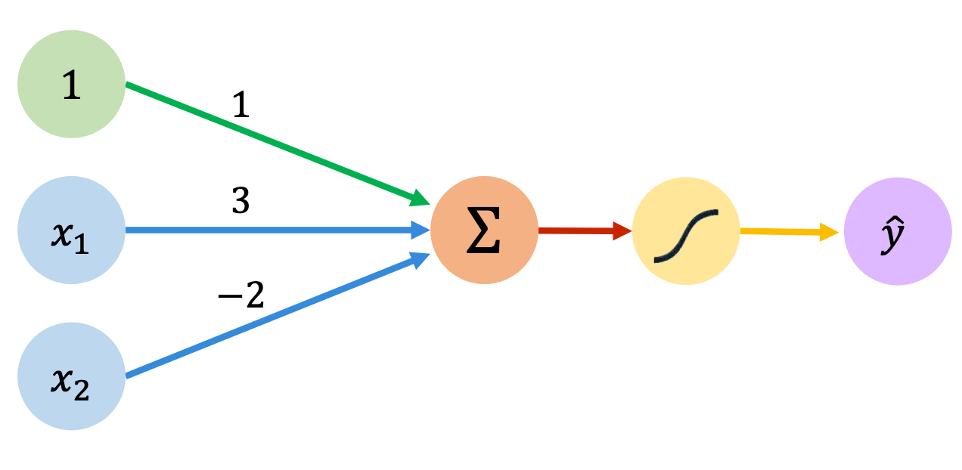
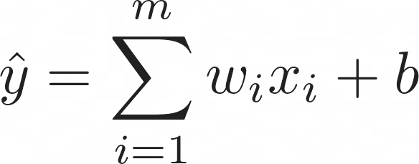
Perceptron & Activation
Binary Classification Task
0

Slide 22
Perceptron & Activation
Binary Classification Task
0

Slide 23
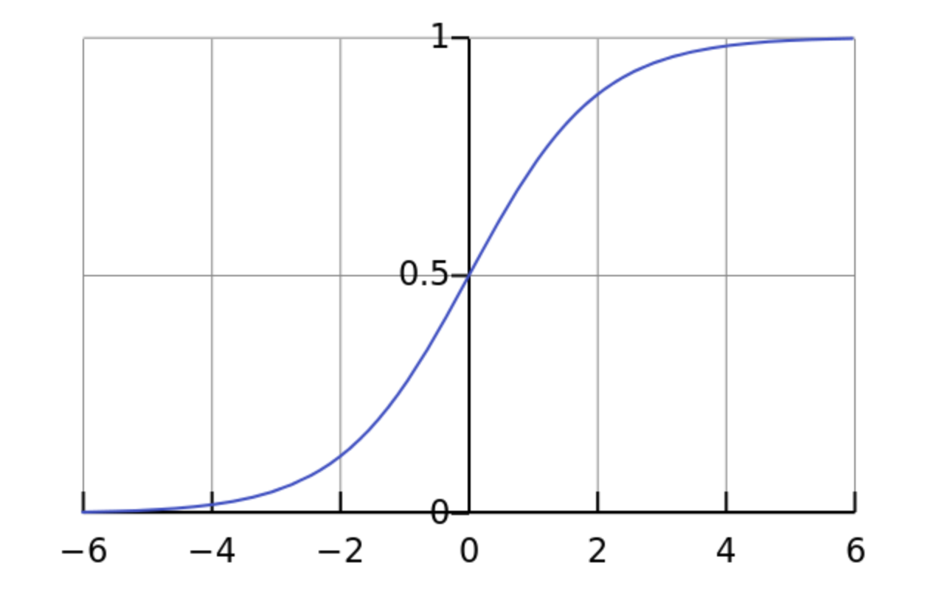
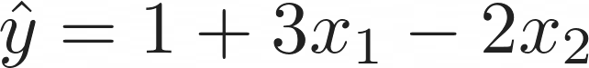
Perceptron & Activation
Binary Classification Task
Sigmoid
0

Slide 24
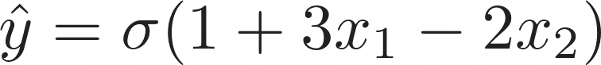
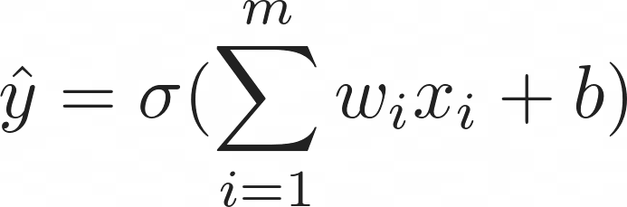
Perceptron & Activation
Binary Classification Task
Sigmoid
0

Slide 25
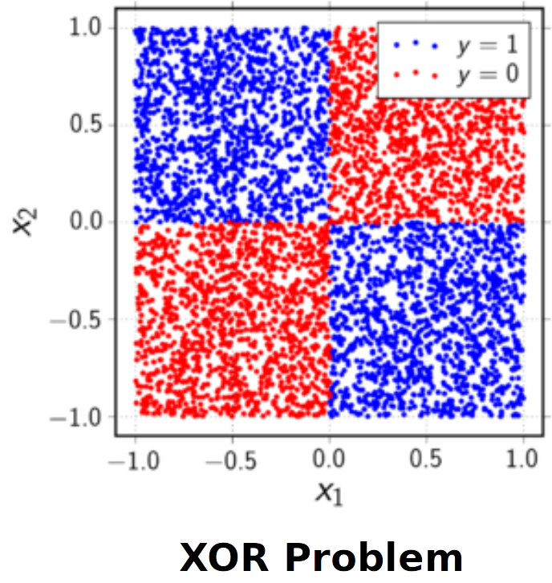
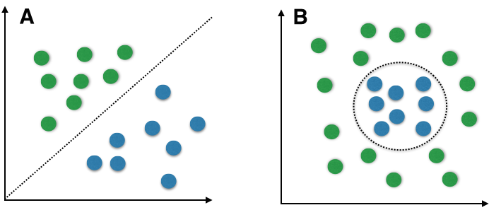
Limitation of Linear Single-Layer Classifiers
Possible solutions:
Add more layers (deep learning)
Map into another (higher dimensional) space

Slide 26
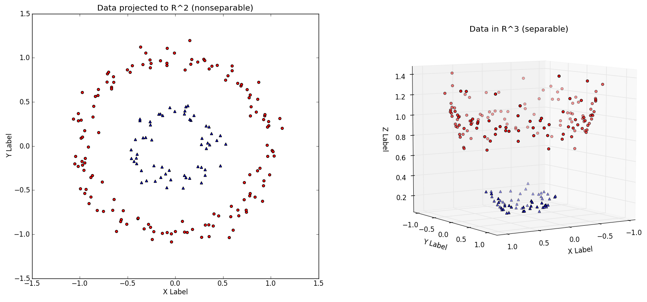
Kernel Trick

Slide 27
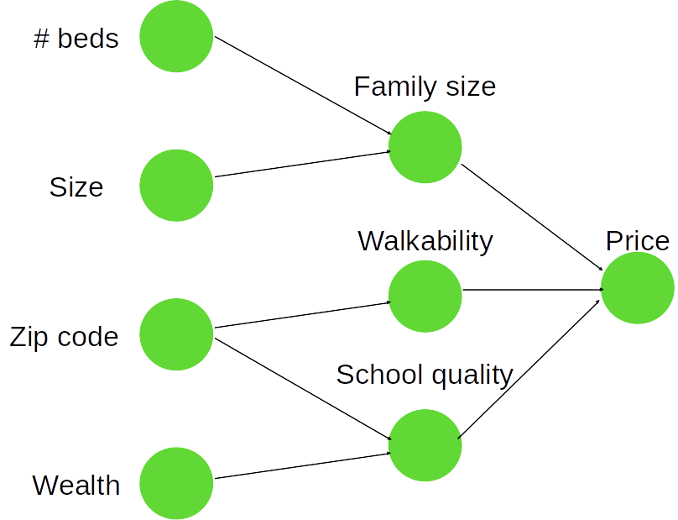
Adding Layers
House price prediction
Input
Hidden Layer
Output

Slide 28
Adding Layers
House price prediction
During the optimization process,
The machine learns to encode a representation that maps the input to the output
?
?
Input
Hidden Layer
Output

Slide 29
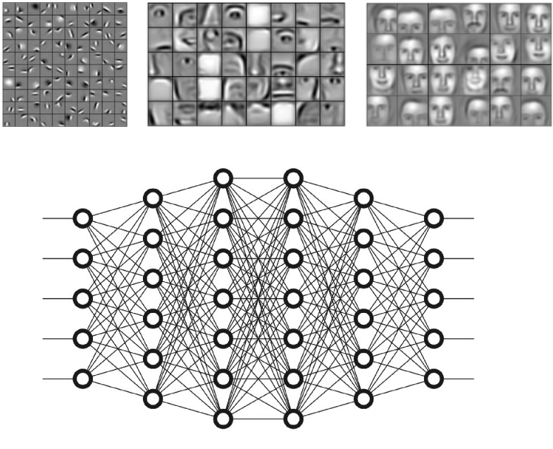
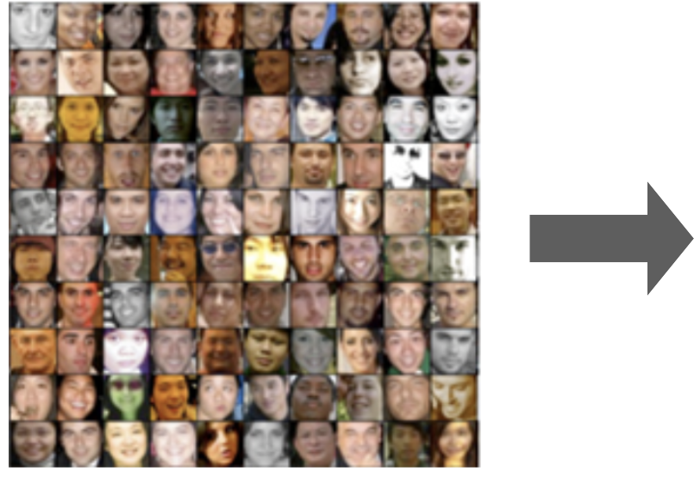
Adding Layers
A deep neural network encodes the representation in an increasingly abstract way

Slide 30

Adding Layers
Neural networks are made from neurons and edges
A collection of neurons in a layer
The output of previous layer is used as an input to the next layer
The input layer is data input and the output is a prediction
Anything in between is hidden
Layers are represented as vectors
Edges are usually represented as matrices - The weights
We train the weights

Slide 31
Adding Layers
Universal Approximation Theorem
“Given a neural network with a single hidden layer of sufficient size, the network can
Approximate any continuous function”
In other words:
There exists a true function relating the inputs to the outputs
A neural network can approximate this function to arbitrary precision given sufficient layer size
The required layer size can be extremely large and grow rapidly with the dimensionality of the problem
Use multiple hidden layers Encoding becomes increasingly more abstract

Slide 32
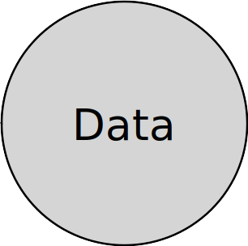
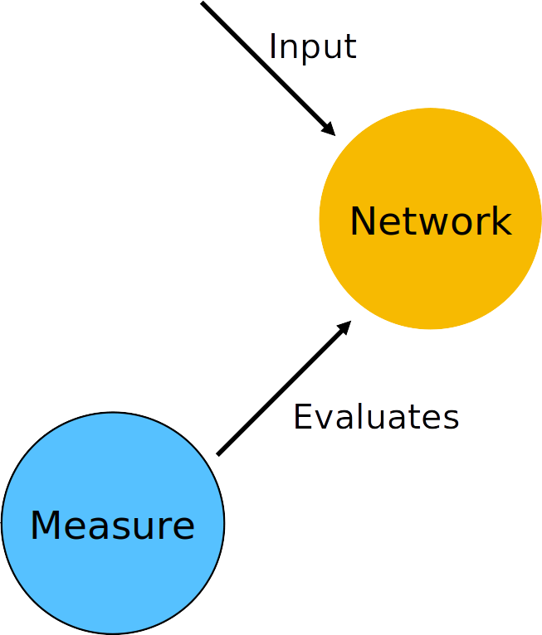
Adding Layers
Estimate
Loss
Ground Truth

Slide 33
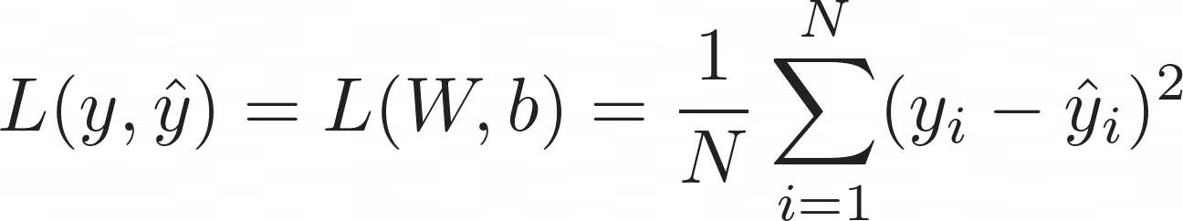
Adding Layers
Estimate
Loss
Ground Truth

Slide 34
Adding Layers
Estimate
Loss
Ground Truth

Slide 35
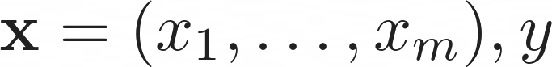
Adding Layers
Estimate
Loss
Ground Truth

Slide 36
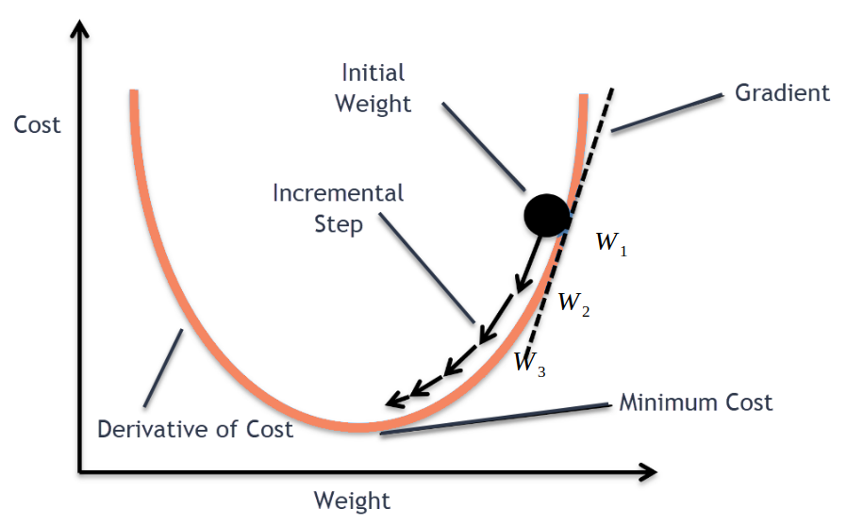
Training a Neural Network

Slide 37
Training a Neural Network

Slide 38
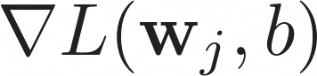
Training a Neural Network

Slide 39
Training a Neural Network
Learning Rate

Slide 40
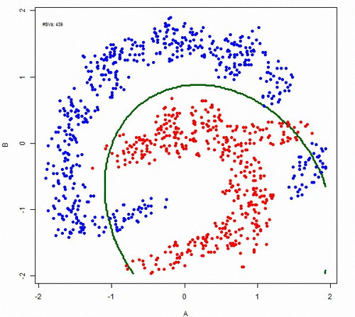

Overfitting
Do we want the lowest loss? Not Really

Slide 41
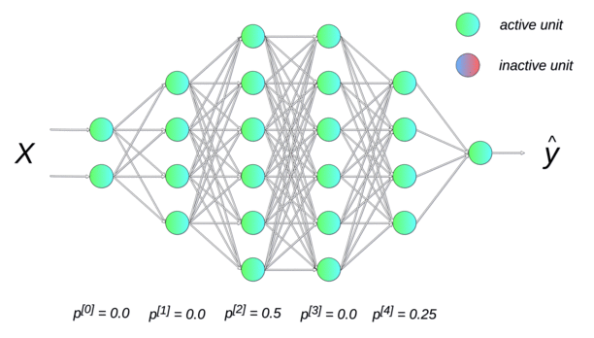
Overfitting
We have to combat overfitting
A few ways to do so is by:
Simply stopping training earlier
Dropout: deactivate a neuron and its connections
for the forward propagation with a certain probability
Decay the value of your weights over time

Slide 42
Training: Backwards Propagation
Forwards Propagation

Slide 43
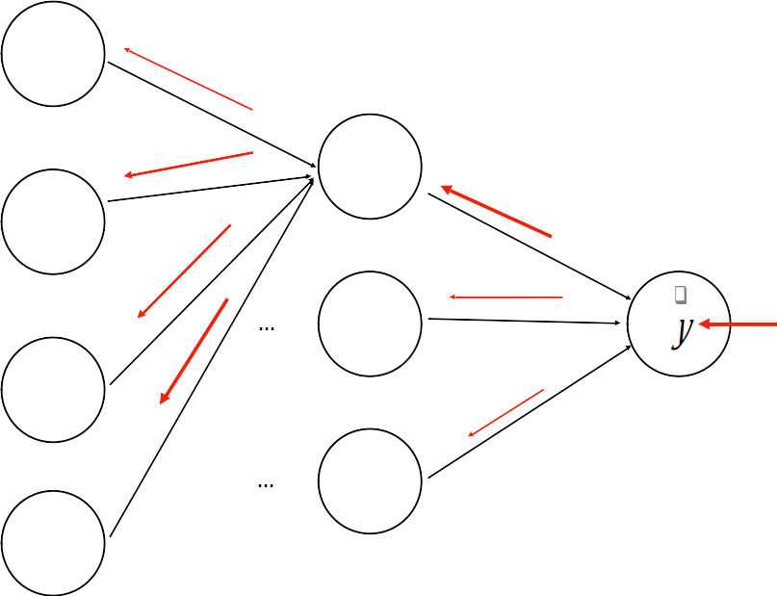
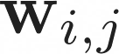
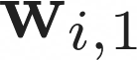
Training: Backwards Propagation
Backwards Propagation
A (deep) neural network is a deeply nested functions:
We need to compute the gradient for each layer
Apply the chain rule
This is backpropagation

Slide 44
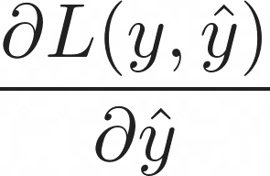
Training: Backwards Propagation
Backwards Propagation
A (deep) neural network is a deeply nested functions:
We need to compute the gradient for each layer
Apply the chain rule
This is backpropagation

Slide 45
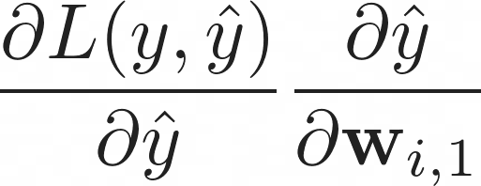
Training: Backwards Propagation
Backwards Propagation
A (deep) neural network is a deeply nested functions:
We need to compute the gradient for each layer
Apply the chain rule
This is backpropagation

Slide 46
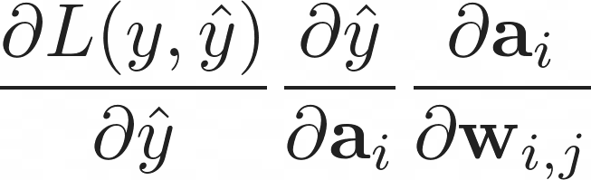
Training: Backwards Propagation
Backwards Propagation
A (deep) neural network is a deeply nested functions:
We need to compute the gradient for each layer
Apply the chain rule
This is backpropagation

Slide 47
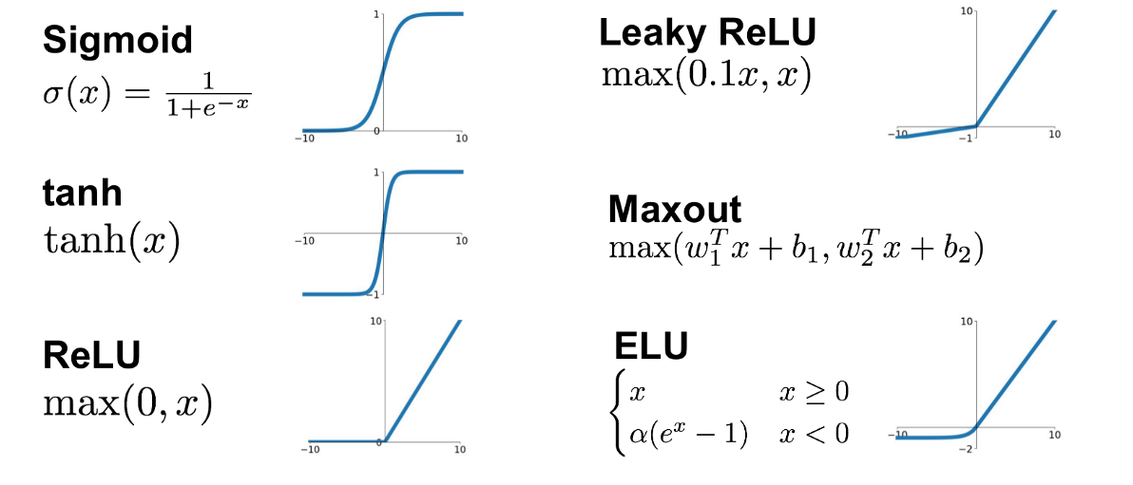
Activation Functions
Many more! We can design our own!

Slide 48
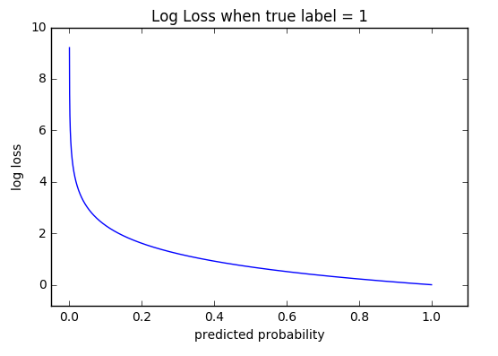
Commonly used loss functions
Regression
Mean Squared Error (MSE)
Mean Squared Log Error
Mean Absolute Error
Binary Classification
Binary cross-entropy
Hinge Loss
Multi-Class Classification
Multi-class cross-entropy
Kullback-Leibler Divergence
Cross-entropy loss outputs a log probability

Slide 49
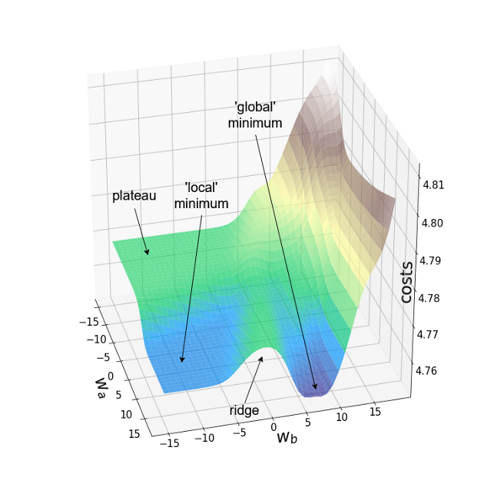
Optimizers
In what way should we change the weights?

Slide 50

Optimizers
In what way should we change the weights?

Slide 51

Optimizers
In what way should we change the weights?

Slide 52
General Workflow of ML
You need to know your data and your models well.
Artificial Intelligence still heavily relies on human intelligence

Slide 53


Imbalanced Training set

Slide 54


Data Normalization
A process to transform the input data in a well-behaved form

Slide 55

Dataset Splitting
70%
20%
10%

Slide 56



Network Evaluation

Slide 57

Workflow

Slide 58

DL Frameworks
In DL you need to
Define neurons and layers
Define loss function
Calculate losses
Calculate gradient
Propagate backward
Update weights
Existing frameworks exist:
TensorFlow (Keras)
Torch
Jax
MXNet

Slide 59

Open Datasets
Processed, balanced, well-behaved and labelled datasets
tensorflow.org/datasets
kaggle.com/datasets
topepo.github.io/caret/data-sets.html
github.com/awesomedata/awesome-public-datasets

Slide 60
Take Home Messages
Machine Learning
New paradigm of programming, driven by data
An optimization process
Deep Learning
A subfield of ML
Relies on deep neural networks
Learns to encode the input data using many layers of concept hierarchies

Slide 61

Take Home Messages

Slide 62

Live Demo
https://playground.tensorflow.org/

Slide 63

PyTorch
Three Levels of Abstraction
1. Tensor: imperative ndarray, possible to run on GPU/TPU
2. (node) Variable: Node in the built computational graph; data, gradient storage
3. (NN) Module: A neural network layer, store the state and the weights of the neural network

Slide 64
PyTorch
Three Levels of Abstraction
1. Tensor: imperative ndarray, possible to run on GPU
2. (node) Variable: Node in the built computational graph; data, gradient storage
3. (NN) Module: A neural network layer, store the state and the weights of the neural network
Pytorch will helps us with:
Defining a dataset
Automatic Gradient Computation
Defining Neural Networks
Optimization
Scheduling
Distributing

Slide 65

PyTorch
https://pytorch.org/docs/stable/

Slide 66
PyTorch
General Structure for training Neural Networks
data loader
model
optimizer
loss function

Slide 67
PyTorch
General Structure for training Neural Networks
data loader
model
optimizer
loss function
For every datapoint, y in data_loader

Slide 68
PyTorch
General Structure for training Neural Networks
data loader
model
optimizer
loss function
For every datapoint, y in data_loader
optimizer.zero_grad()

Slide 69
PyTorch
General Structure for training Neural Networks
data loader
model
optimizer
loss function
For every datapoint, y in data_loader
optimizer.zero_grad()
prediction = model(datapoint)

Slide 70
PyTorch
General Structure for training Neural Networks
data loader
model
optimizer
loss function
For every datapoint, y in data_loader
optimizer.zero_grad()
prediction = model(datapoint)
loss = loss_function(prediction, y)

Slide 71
PyTorch
General Structure for training Neural Networks
data loader
model
optimizer
loss function
For every datapoint, y in data_loader
optimizer.zero_grad()
prediction = model(datapoint)
loss = loss_function(prediction, y)
loss.backward()

Slide 72
PyTorch
General Structure for training Neural Networks
data loader
model
optimizer
loss function
For every datapoint, y in data_loader
optimizer.zero_grad()
prediction = model(datapoint)
loss = loss_function(prediction, y)
loss.backward()
optimizer.step()

Slide 73
PyTorch
General Structure for training Neural Networks
data loader
model
optimizer
loss function
For every datapoint, y in data_loader
optimizer.zero_grad()
prediction = model(datapoint)
loss = loss_function(prediction, y)
loss.backward()
optimizer.step()

Slide 74

PyTorch
General Structure for training Neural Networks
data loader
model
optimizer
loss function
For every datapoint, y in data_loader
optimizer.zero_grad()
prediction = model(datapoint)
loss = loss_function(prediction, y)
loss.backward()
optimizer.step()

Slide 75
PyTorch
General Structure for training Neural Networks
data loader
model
optimizer
loss function
For every datapoint, y in data_loader
optimizer.zero_grad()
prediction = model(datapoint)
loss = loss_function(prediction, y)
loss.backward()
optimizer.step()

Slide 76
PyTorch
Data:
d_1 = [0.9, -0.2], y = 0
d_2 = [0.75, 0.6],y = 1

Slide 77

PyTorch
Data:
d_1 = [0.9, -0.2], y = 0
d_2 = [0.75, 0.6],y = 1

Slide 78
PyTorch
Data:
d_1 = [0.9, -0.2], y = 0
d_2 = [0.75, 0.6],y = 1
Learning rate = 0.01
Optimizer = Stochastic Gradient Descent
Loss = Binary Cross Entropy

Slide 79

PyTorch
Data:
d_1 = [0.9, -0.2], y = 0
d_2 = [0.75, 0.6],y = 1
Learning rate = 0.01
Optimizer = Stochastic Gradient Descent
Loss = Binary Cross Entropy

